Slide 1
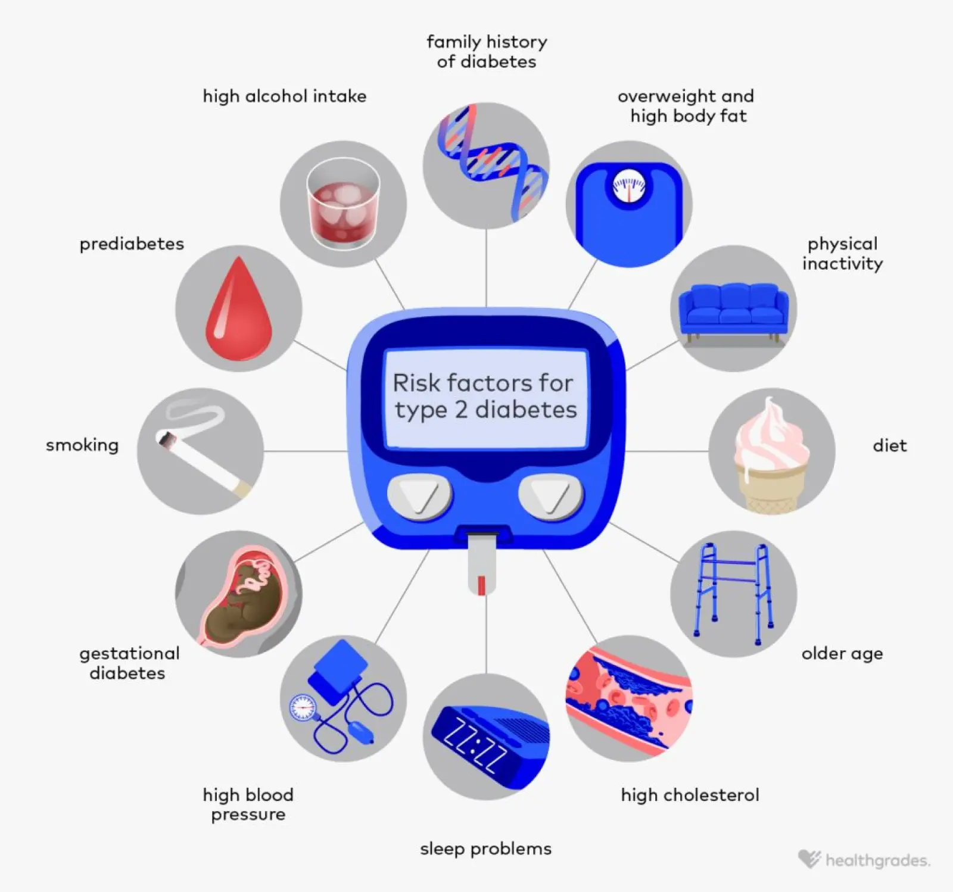
Predicting Diabetes Risk from Smoking Dataset
A Machine Learning Approach
Presenter: Sina, Xiaoqiao (Pamela), Farwa
Course: SCS_3253
Source: Risk Factors for Type 2 Diabetes: A Guide
Notes:
Sina

Slide 2
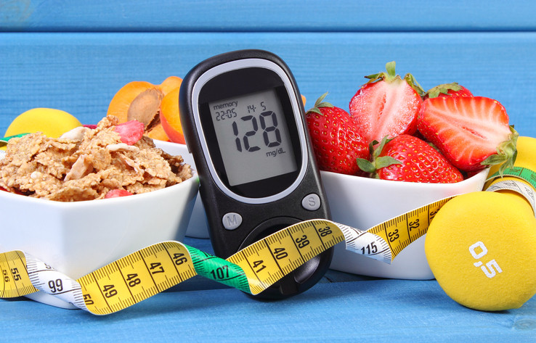



Project Goal & Data
Goal
Predict whether an individual is at risk for diabetes given dataset of health features.
Dataset
15k initial rows. 23 features used.
could not use test.csv dataset from kaggle
Target Variable
0: No Risk (FBS < 100 mg/dL). 1: At Risk (100-125 mg/dL).
2: Prediabetic (FBS >125 mg/dL).
Source: Good news for those with type 2 diabetes: Healthy lifestyle matters (Harvard Health)
Notes:
Sina

Slide 3
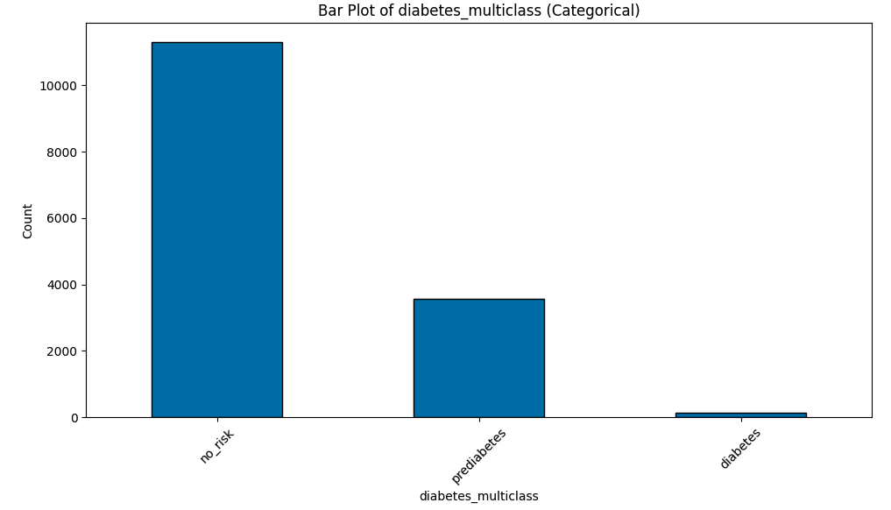
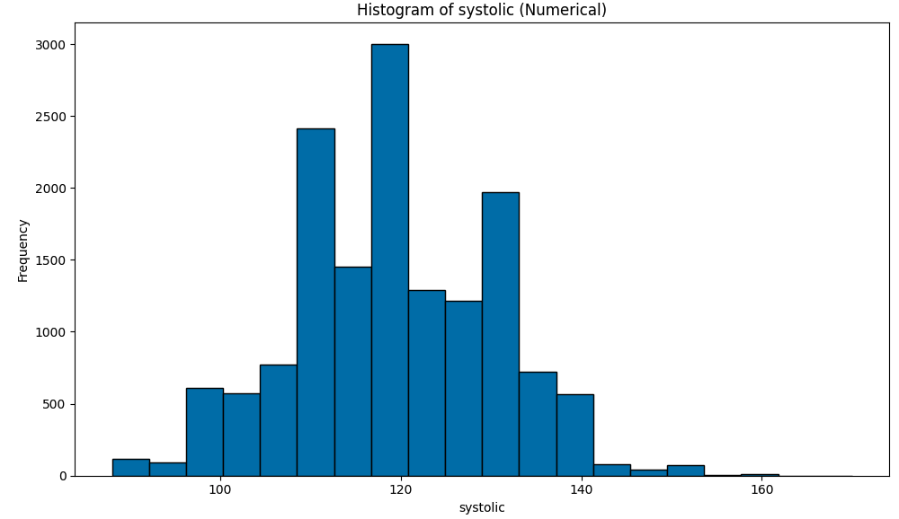
Data Exploration
Age (5-year gap)
Height (cm)
Weight (kg)
Waist circumference (cm)
Eyesight (left)
Eyesight (right)
Hearing (left)
Hearing (right)
Systolic blood pressure
Diastolic blood pressure (relaxation)
Total Cholesterol
Triglyceride
HDL cholesterol
LDL cholesterol
Hemoglobin
Urine protein
Serum creatinine
AST (glutamic oxaloacetic transaminase)
ALT (glutamic oxaloacetic transaminase)
GTP (γ-GTP)
Dental caries
Smoking status
Feature variables:
4 categorical features
18 numerical features
Labels:
diabetes_multiclass
Observations:
No missing value
Some numerical features are skewly distributed. No apparent outliers found (Ex. Systolic blood pressure)
Notes:
Sina

Slide 4

Challenges
Significant class imbalance. 'Prediabetic’ minority class (~0.92%) [138/15,000]
Not removing Fasting Blood Sugar from training data (rule-based approach)
SMOTE on entire dataset before splitting to training/testing
Dataset was not intended for diabetes classification
Feature Engineering did not provide any benefit to accuracy (Ex. BMI)
Notes:
Sina

Slide 5
Methodology
Preprocessing
SMOTE
Feature Engineering (BMI calculation, height to weight ratio)
Dropping unnecessary columns (ID, Fasting Blood Sugar)
Handling Missing Data
Label Encoding
Feature Scaling (StandardScaler)
Splitting training data into train/test (Kaggle had separate train/test)
Notes:
Sina

Slide 6
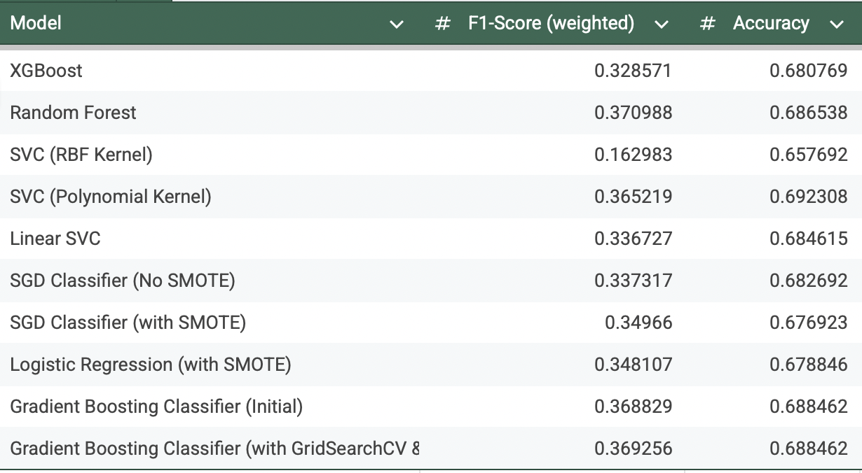
Models Evaluated
Logistic Regression (LR)
Support Vector Classifier (SVC)
Random Forest (RF)
XGBoost (XGB) - Often for imbalance dataset
SGD Classifier
Gradient Boost Classifier
Imbalance Handling
Auto Class Weighting
Notes:
Farwa

Slide 7
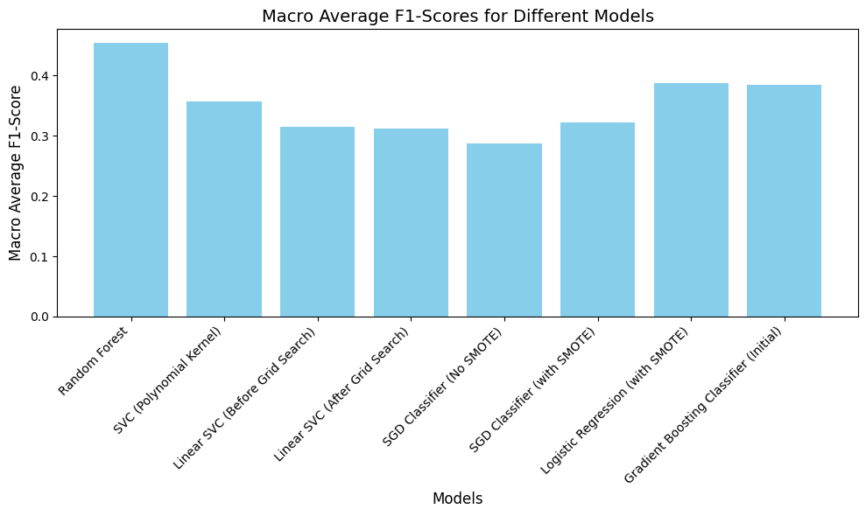
Macro Average Visualized
Notes:
Farwa

Slide 8
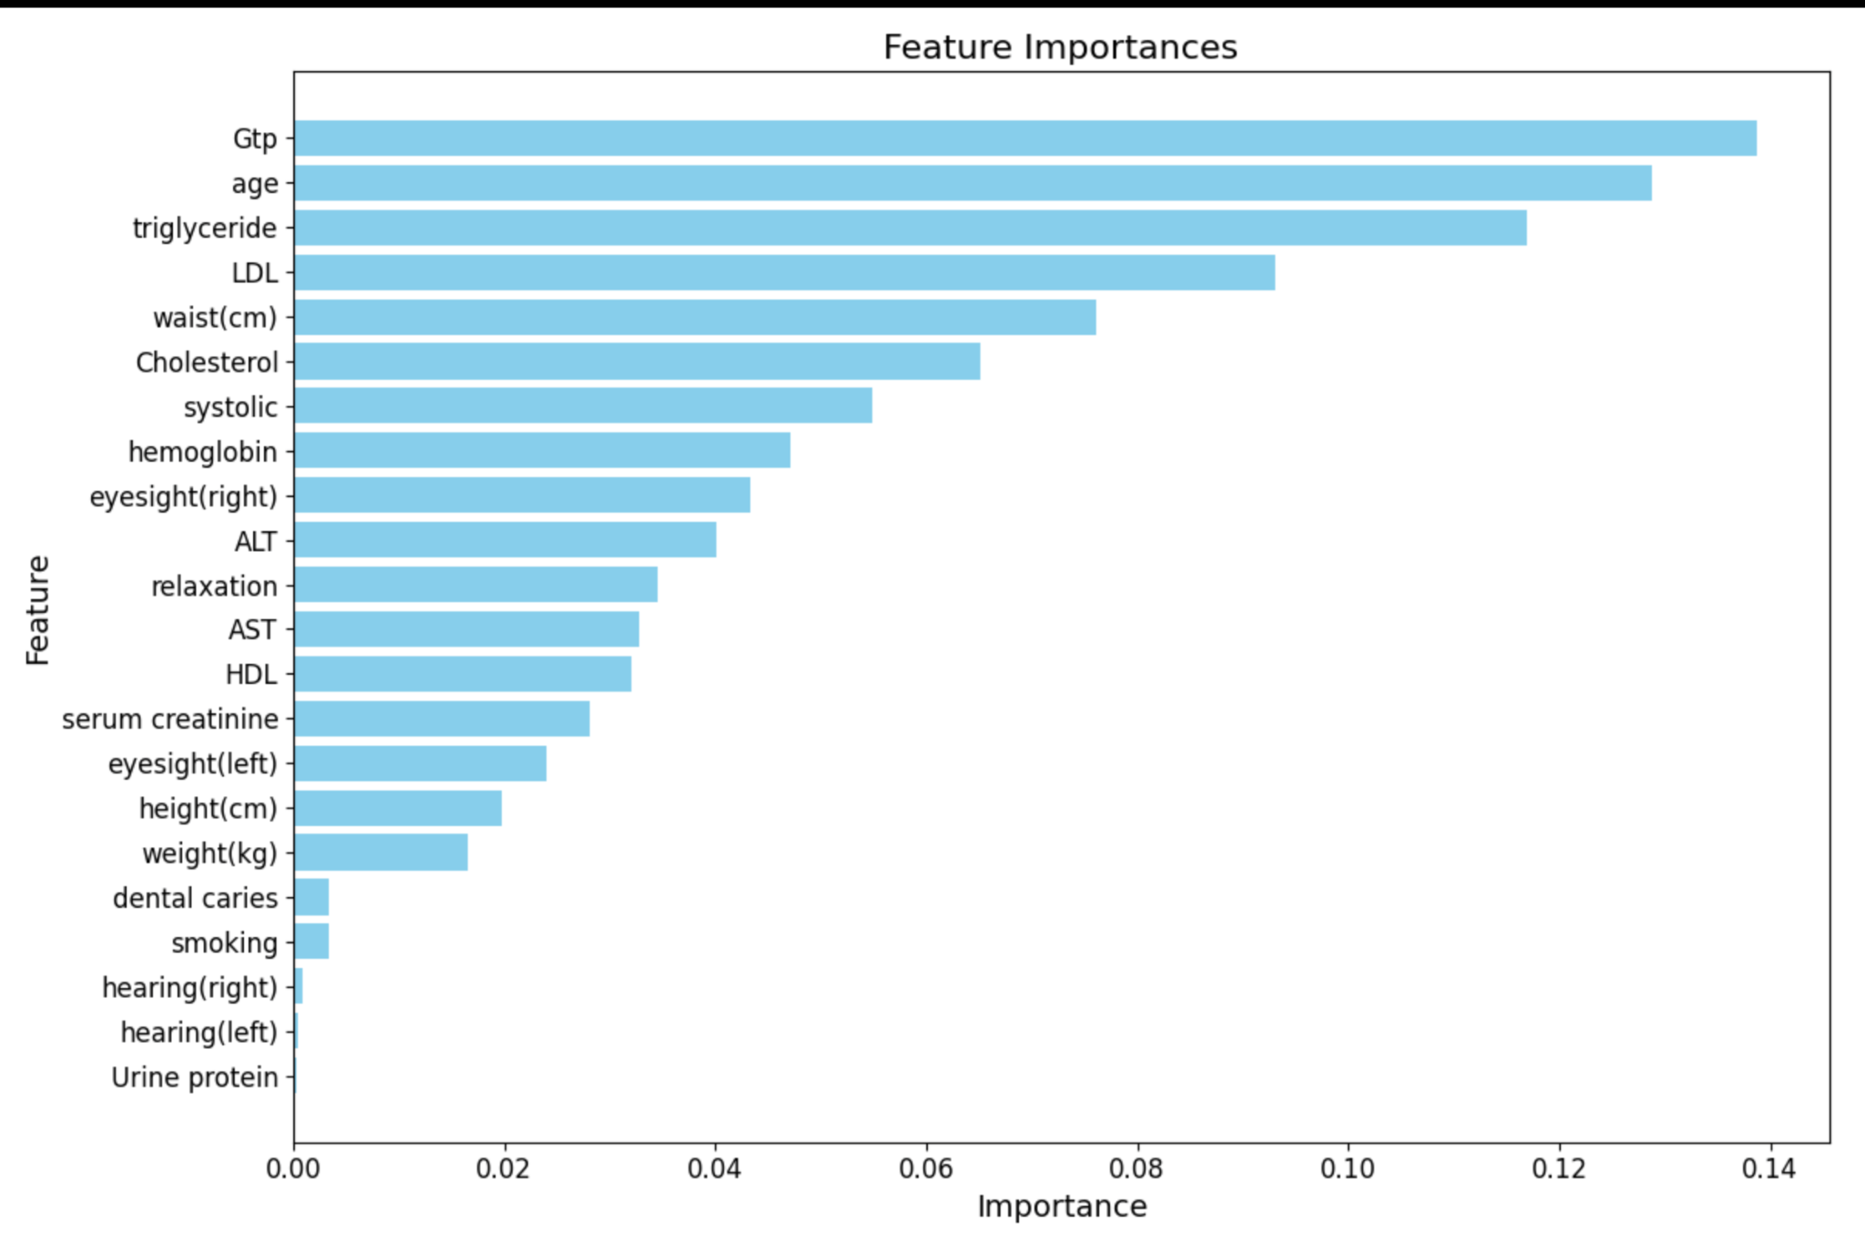
Feature Importance - Random Forest
Our Findings:
GTP stands for Gamma-glutamyl transferase (GGT). It's an enzyme that's primarily found in the liver but is also present in other organs like the kidneys and pancreas.
High levels of GTP can indicate liver damage or disease.
Our model rates GTP as of the highest importance.
Notes:
Farwa

Slide 9
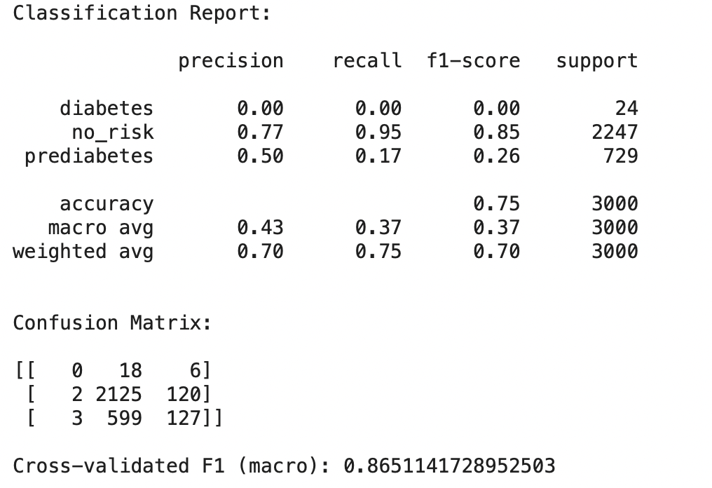
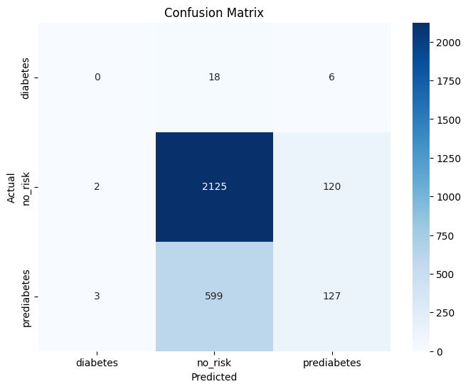
XGBoost Results
Misleading Accuracy
Adjusting Classes to only no_risk and diabetes
Notes:
pam

Slide 10
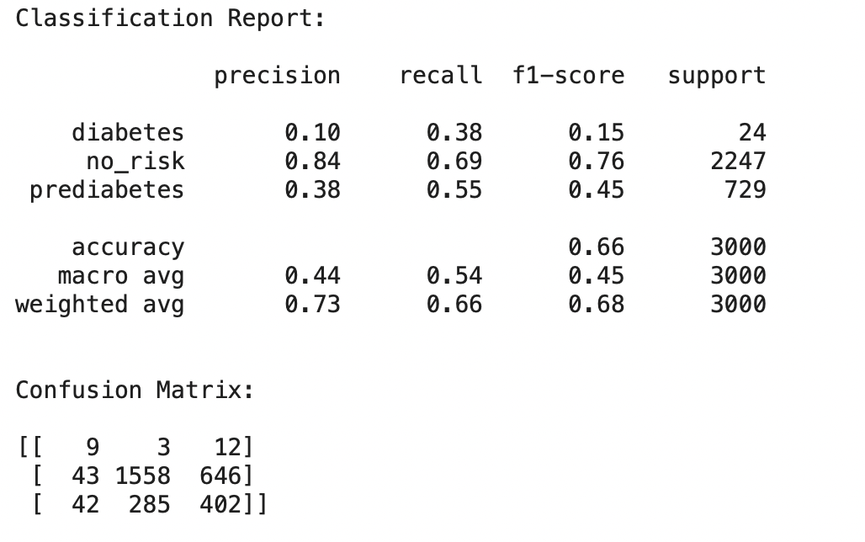
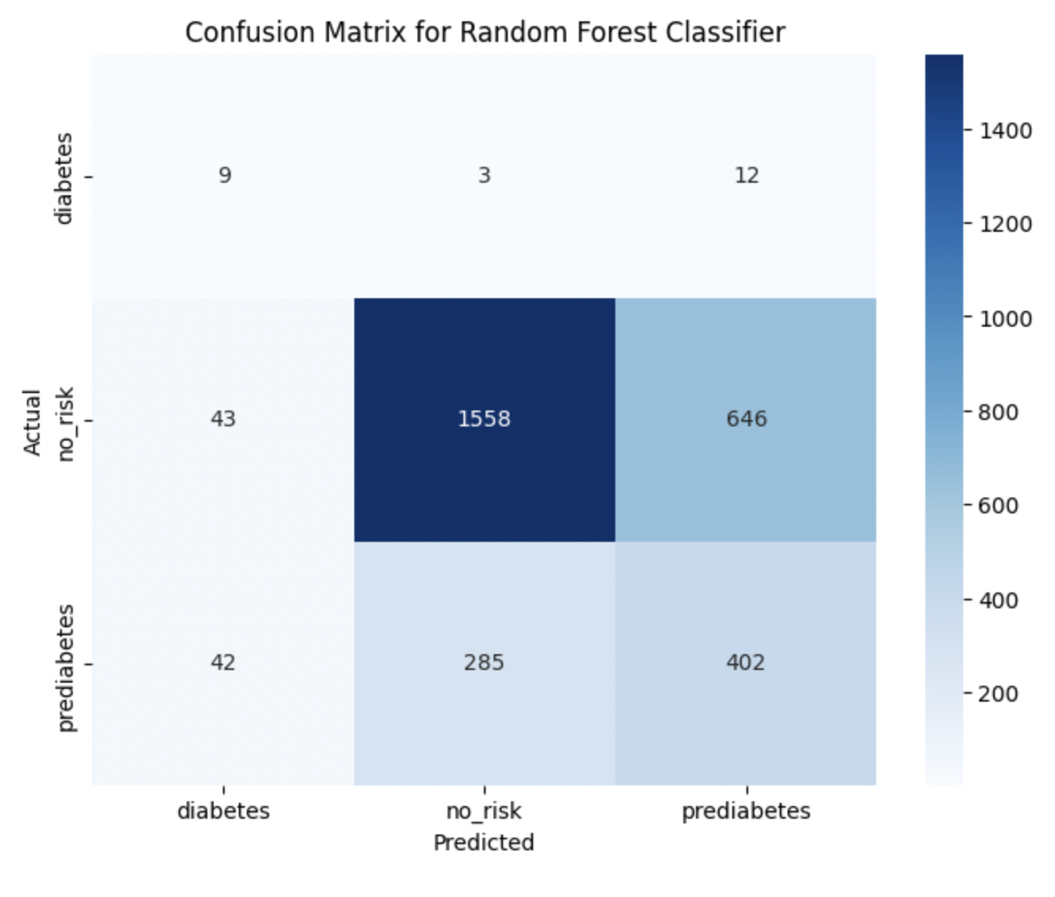
Random Forest Results
Auto class weighting (class_weight='balanced')
Notes:
pam

Slide 11


Conclusion & Next Steps
Next Steps
Explore other models for imbalanced dataset
More Rigorous Hyperparameter Tuning (RandomizedSearchCV, Bayesian Optimization)
A dataset related to diabetes with more balanced classes
Other methods to correct for imbalance
Selecting most important features
More feature engineering
Notes:
pam

Slide 12




Questions?

Slide 13
References
Smoking dataset: https://www.kaggle.com/competitions/binary-smoke-detector
Gamma for Presentation template

